Slide 1
Welcome Session 2021
Department of Computer Science

Slide 2
Introduction to Computing

Slide 3
Introduction Of Teacher and T.F.:
Dr. Syed Khaldoon Khurshid
(Assistant Professor)
Department of Computer Science
I will be teaching theory class and
Mr Laiq (Teaching Fellow) for Lab.

Slide 4
Contact details
Email: khaldoon@uet.edu.pk
Office:
Computer Science Department (1st Floor)
University of Engineering and Technology, Lahore
Course Contents, CLOs and PLOs

Slide 5
Lecture Format
Lectures will be preferably delivered in English.
Lecture through multimedia and white board.
Most important part of learning in university is individual test.
Class participation is encouraged throughout the course.
Attendance marks will effect your final grades.

Slide 6
Marks distribution of the course
Theory Total= 100 Marks
Final paper contains 40% Marks
Mid-terms contain 30% Marks
Quizzes contain 30% Marks
Class Project Total= 100 Marks
Class projects contain 100% Marks

Slide 7
Theory Quizzes
They may be written (or) verbal.
Two main Quizzes.
There can be number of surprise quizzes throughout the semester.

Slide 8
Book and Application:
Recommended Book:
Computer Science an Overview
Author: J. Glenn Brook Shear
Brilliant Application

Slide 9
A piece of advice before start of formal Lectures
In semester System there is very little time for students to waste.
Don’t indulge yourself in other activities except your studies.

Slide 10
Home Assignment Question:
What is Computer Science?
Google it

Slide 11

Descriptive Example to make
you understand “Computers”
Description by Richard Feynman about computers
Example of Librarian

Slide 12


Introduction: Computer Science - What is it? (1)
A combination of many things...
includes a.o.:
(1) hardware design, (2) programming, (3) human computer interaction, (4) artificial intelligence, etc...
in other words:
mathematics, engineering, psychology, linguistics, biology, business administration, ethics, sociology, …
Certainly not:
‘science’ of computer applications
‘science’ of programming in language ‘X’

Slide 13
Introduction: Computer Science - What is it? (2)
Science of algorithms:
algorithm (informally):
set of steps that defines how a task is performed
Our Knowledge of algorithms would be the main driving force behind modern technology and this book
machine-compatible representation = ‘program’
central issues:
(1) algorithm discovery
(2) algorithm representation
(3) handling complex collections of algorithms
(4) hardware implications, ...

Slide 14
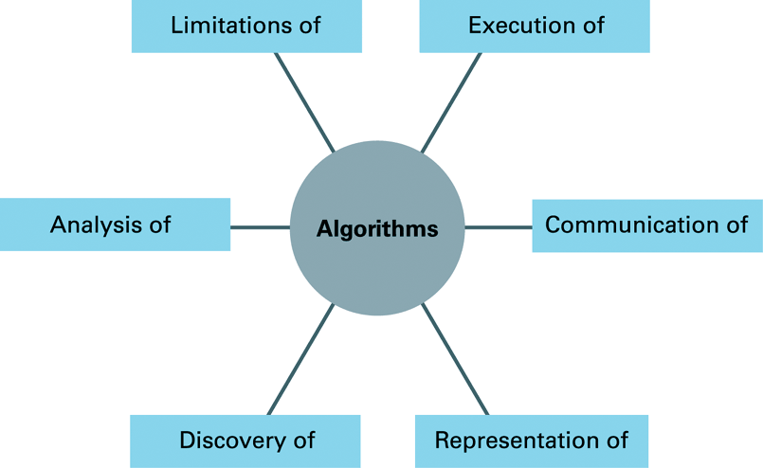
The central role of algorithms in computer science

Slide 15
Orientation of Book
Discovery
Discover solution of a problem - Chapter 4
Representation
Communication to Machine-Programming Languages
Programming Languages are based on programming paradigms or processes- Chapter 5
Communication
Communication among the algorithms - Chapter 10
Interaction among the components - Chapter 6
Computer Architecture – Data storage, presentation, manipulation and Retrieval - Chapters 1, 2, 7, 8 & 9

Slide 16
Orientation of Book (2)
Execution
The design of large software system involve more development of individual algorithms for performing the required activities.
Software Engineering - Project management, Personal management and programming language design.
Software Engineering also deals with the development of the tools - Chapter 6
How algorithms will be stored in machine? How algorithms will be executed by machine - Chapter 3
Human intelligence is and will be simulated to machines so that machine can perform more activities like humans. Chapter 10

Slide 17
Orientation of Book (3)
Limitations
In Early 1900 Kurt Godel proposed “incompleteness theory”:
“Any Complete study of our arithmetic system lies beyond the capabilities of algorithmic activities”
Limitation of algorithms study limits the mathematical studies to design hypothetical machines- Chapter 11
Analysis
Analysis of algorithms is important to know which algorithm is more efficient and correct - Chapter 4

Slide 18
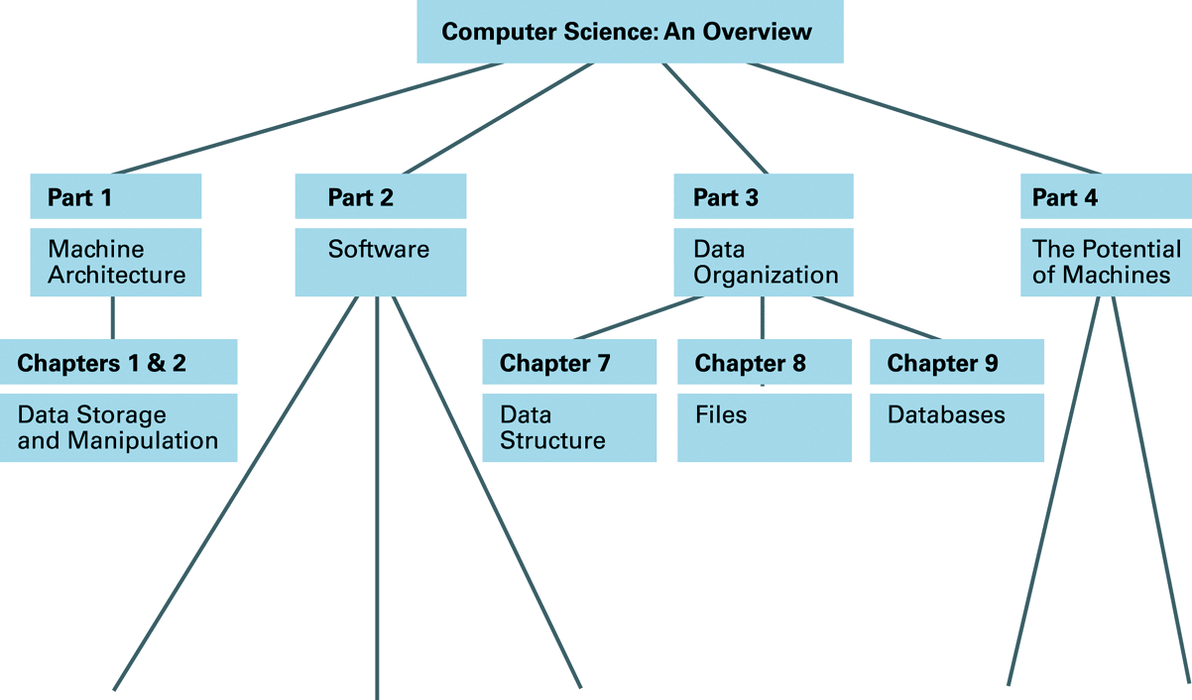
Figure 0.7: Viewing this text, itself, as a hierarchy of abstract tools (continued)

Slide 19
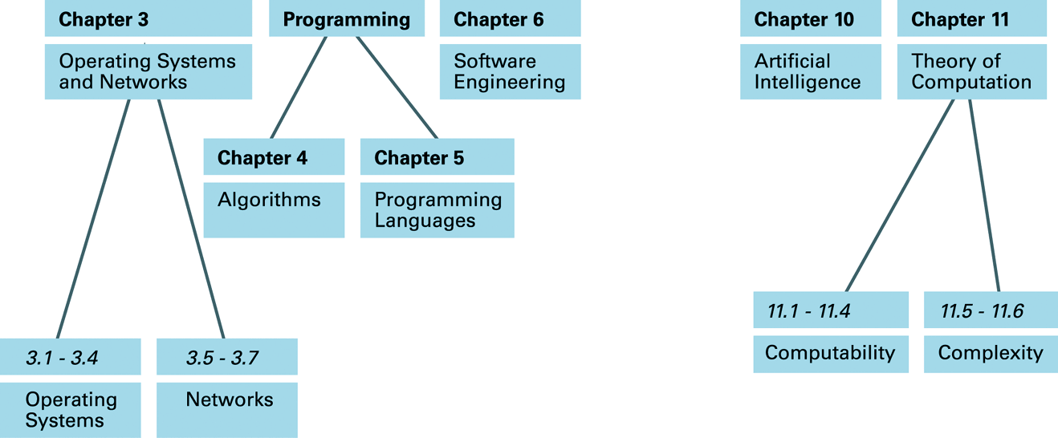
Figure 0.7: Viewing this text, itself, as a hierarchy of abstract tools

Slide 20
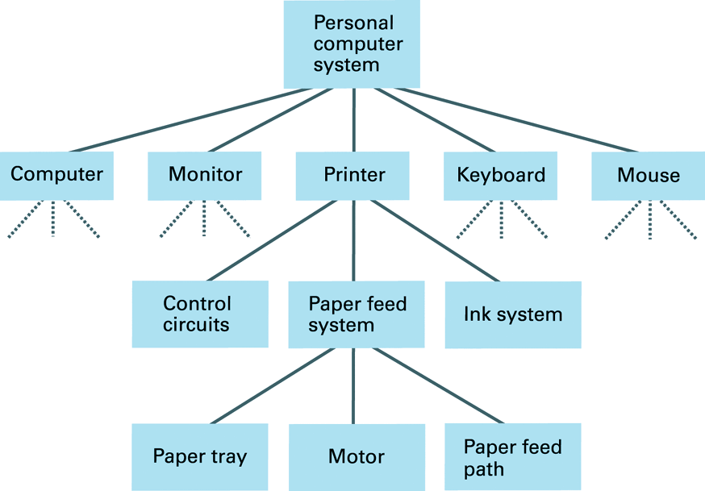
Figure 0.6: The hierarchy of abstraction in the hardware of a typical personal computer

Slide 21
One Hour Class End

Slide 22
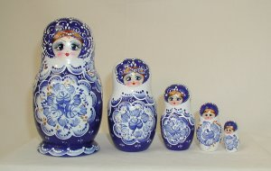
Introduction: Computer Science - What is it?
Science of ‘abstraction’:
obtaining external properties of an entity, by hiding its internal details.

Slide 23
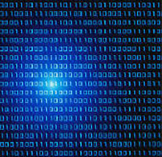
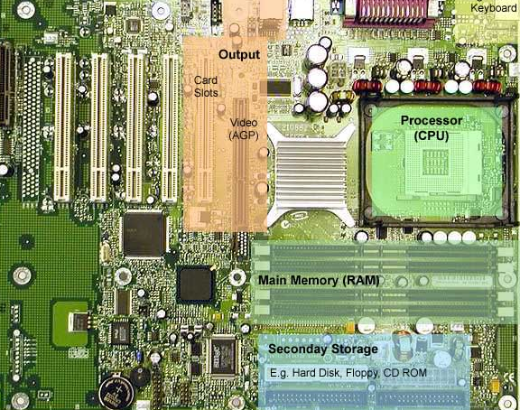
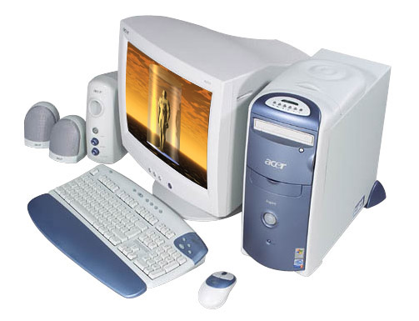
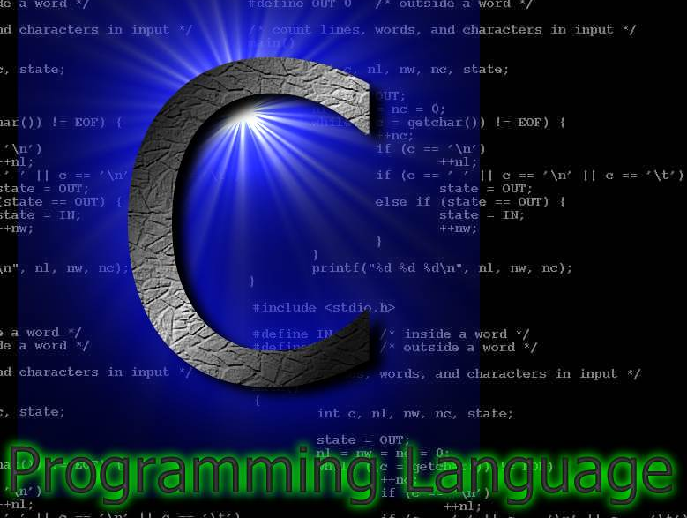
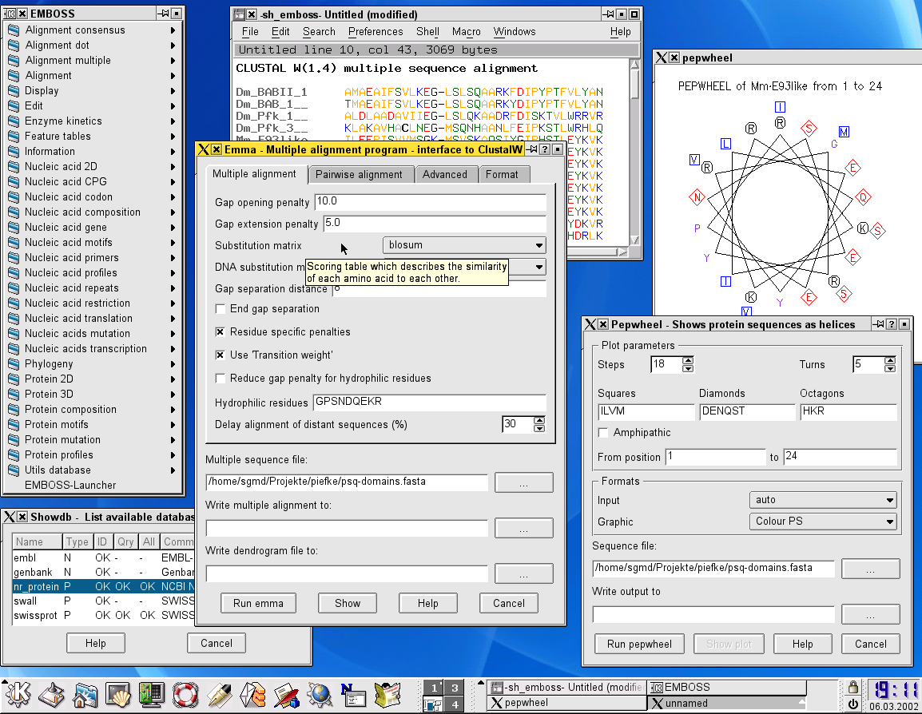
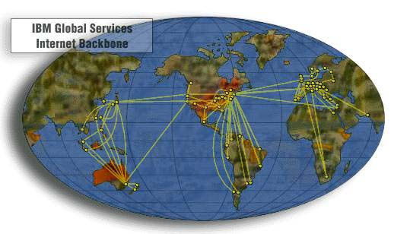
Introduction: Computer Science - What is it?
Abstraction... on abstraction... on...

Slide 24
Computer Science in relation to desktop PC...
2. Software
(Operating Systems, Programming, ...)
4. Potential of Computers
(A.I., Theory of Computation, …)
3. Data Organization
(Data Structures, File Structures, Databases, …)
1. Machine Architecture
(Data Storage, Data Manipulation, ...)

Slide 25
The origin of computing machines
First Computing device: Abacus
Mechanical Devices before the invent of Electricity
Efforts by Pascal, Leibuiz and Charles babbage
Babbage’s machine was programmable
Augusta Ada is considered first programmer
After the invention of electricity
1944- Mark I at Harvard university
Obsoleted soon, because work on vacuum tube technology has been done to construct Electronic Digital Computers
1945- ENIAC- Electronic Numerical Integrator Calculator
1981- PC- IBM first personal Computer, software by Microsoft

Slide 26
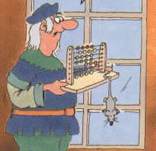
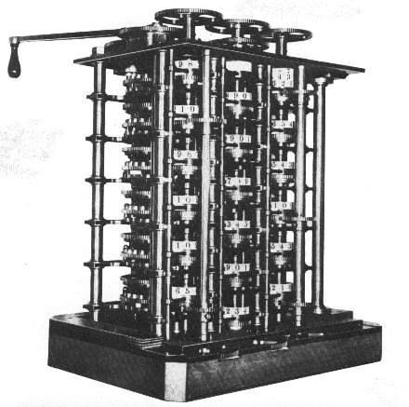
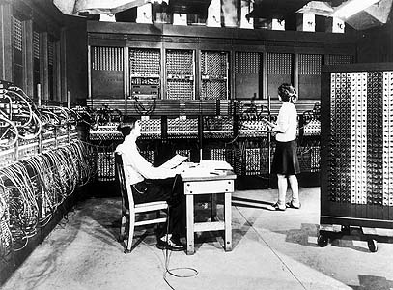
Central issues identical in the past...
- Abacus (ca. 50 BC)
- Difference Engine (Babbage, ca. 1822)
- ENIAC (Univ. of Pennsylvania, 1945)

Slide 27
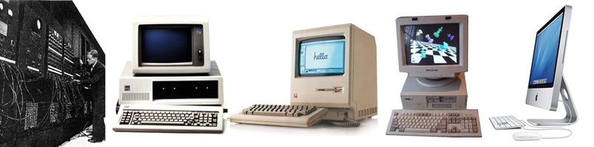
The Evolution of Computers: Then & Now

Slide 28
Questions:
Can you think of any other common computing device other than computers?
Mobiles
Correct Answer
But Why?

Slide 29
Today Mobiles and Devices

Slide 30
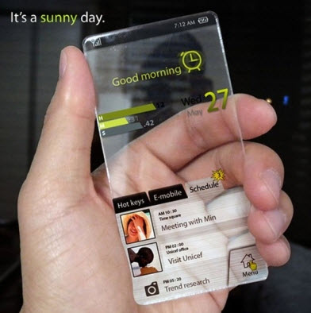
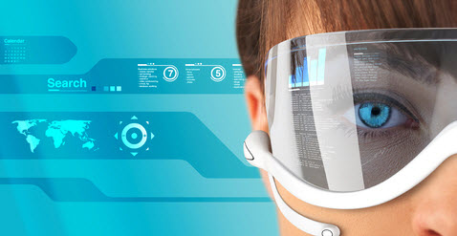
Dream Smartphone Devices| Intelligent Personnel Assistant Mobile
No need to take tension about its charging time. it can be charge from body heat or electromagnetic waves.
it check my mood and set the wallpaper of mobile phone according to my mood.
Make a record of my decision and give me opinion is my every day problem.
Detecting your Geo location and hence providing you help like mulch-language translation support and best traffic routing via GPS.
Direct satellite connection for 24/7 uninterrupted service/internet connection.
Looking at your schedule and replying to an incoming invitation for a party/get together.
Fully voice functional.
Ability to provide you suggestion about your schedule/adjusting your schedule as it best fits.
Behavior based detection of messages hence informing you about the important ones only.
Practically 100% unbreakable and stealth proof/secure

Slide 31
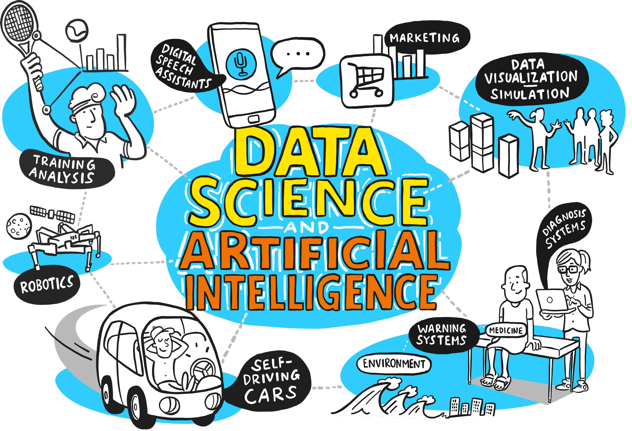

Slide 32
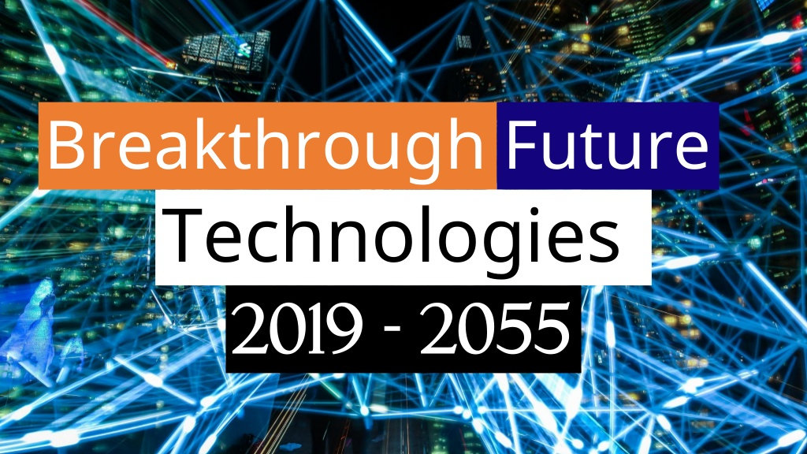

Slide 33
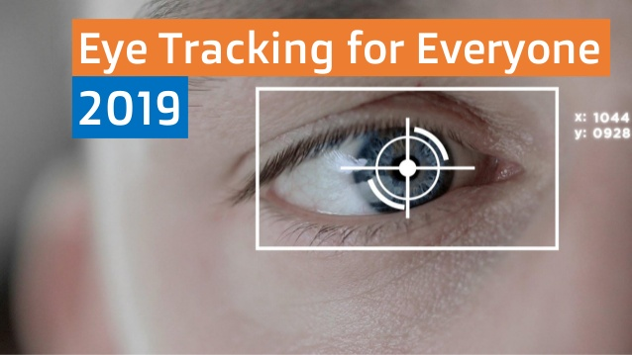

Slide 34
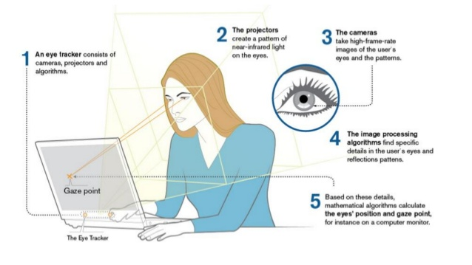

Slide 35
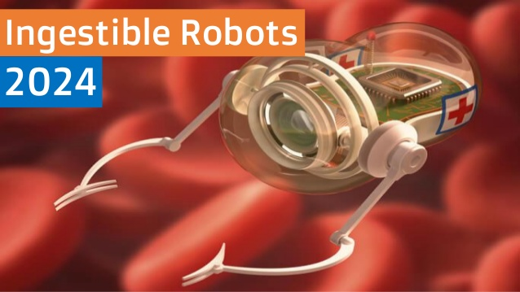

Slide 36
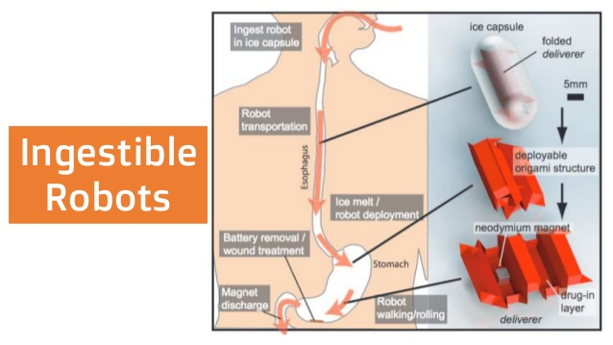

Slide 37
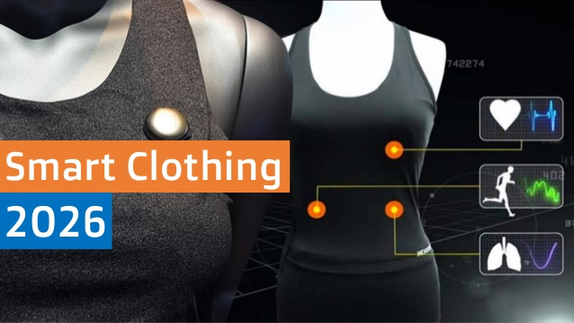

Slide 38
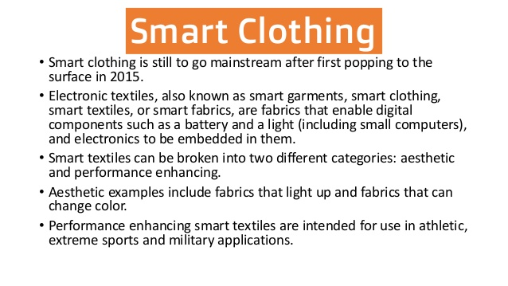

Slide 39
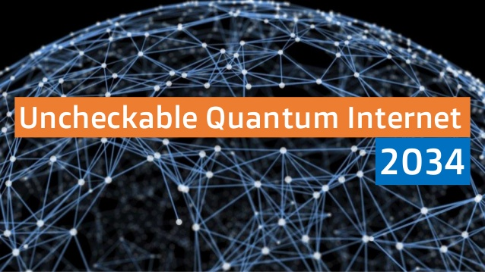

Slide 40
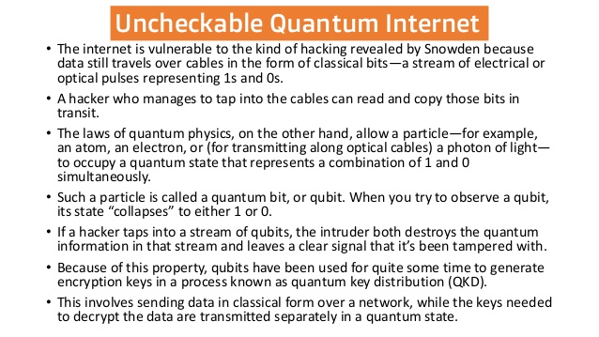

Slide 41
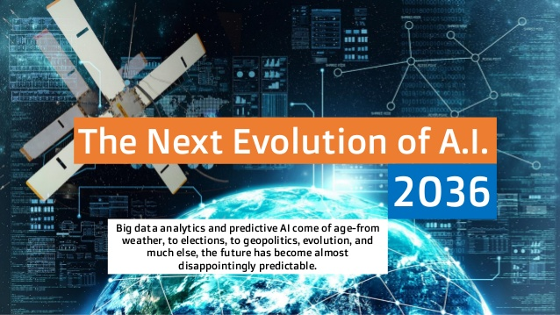

Slide 42
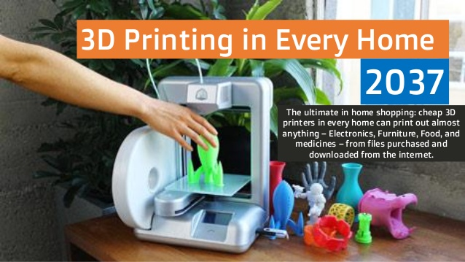

Slide 43
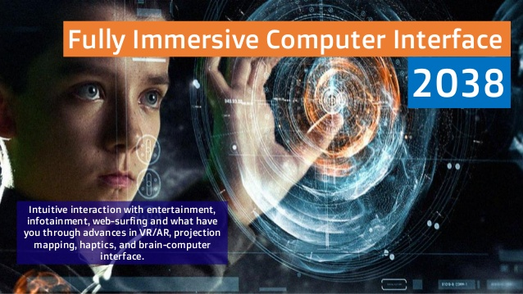

Slide 44
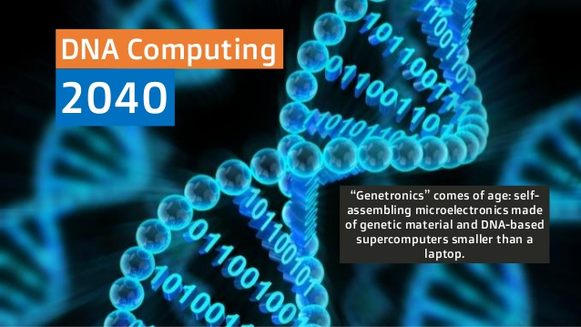

Slide 45
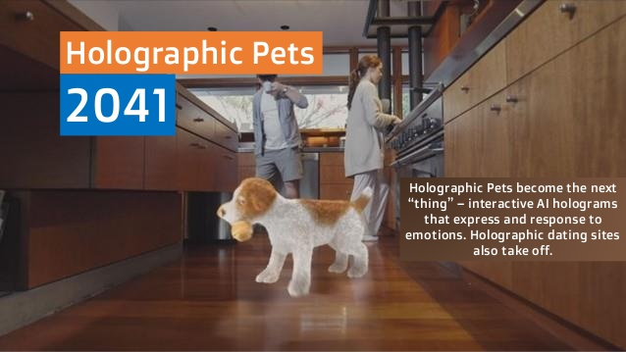

Slide 46
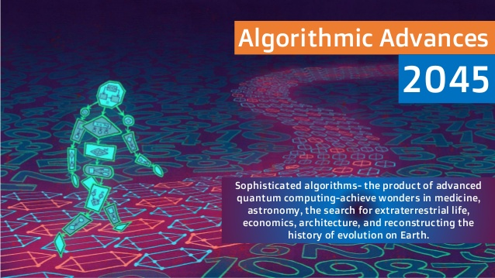

Slide 47
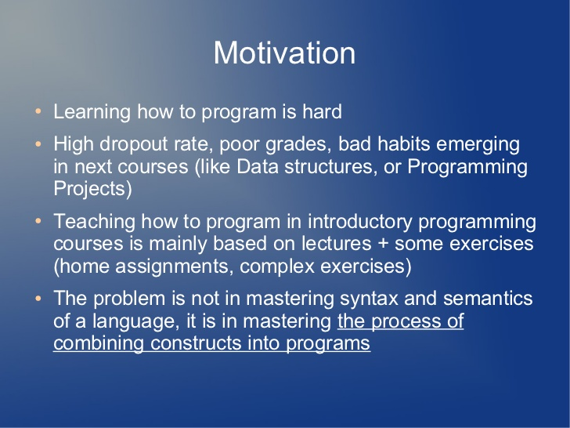

Slide 48
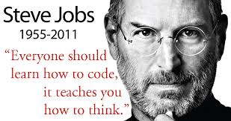

Slide 49
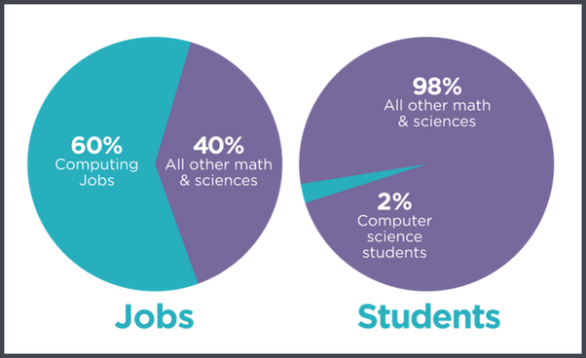

Slide 50
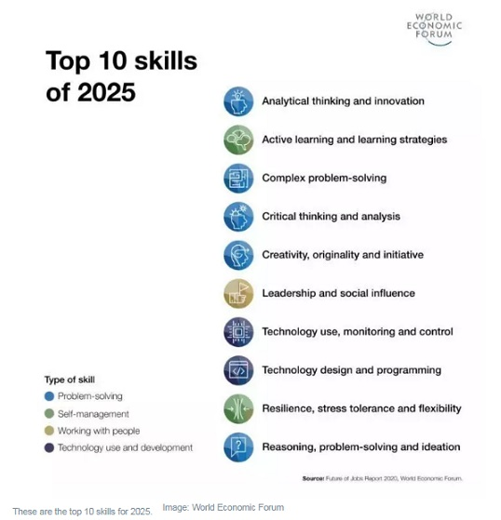
Ref: https://www.weforum.org/agenda/2020/10/top-10-work-skills-of-tomorrow-how-long-it-takes-to-learn-them/

Slide 51
Home Assignment
Create your own Gmail email address; if you don’t have one.
You all will be joining Google groups for class contents and materials.

Slide 52
Last topic of Chapter: Introduction
Ethical, Social and Legal Repercussions
Home work
Verbal presentation in the next class

Slide 53
Any Questions?
Notes:
Reading
Richard Fayman -> Biography -> Interesting to read-> Physics lectures
Algorithms are eating our work-> Ted Talk.
Computer Limitations -> Travel’s sale man problem.
Contents are books, Grading -> not required
Less Text should be replaced by Images.
Slides makes students passive.

